Slide 1
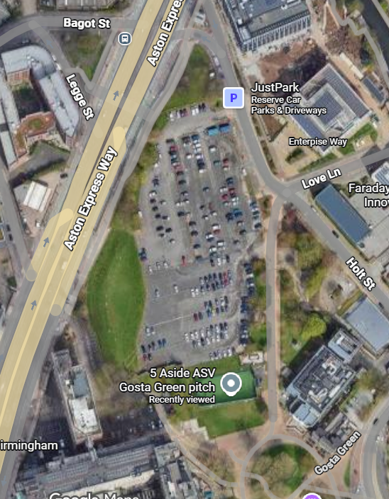
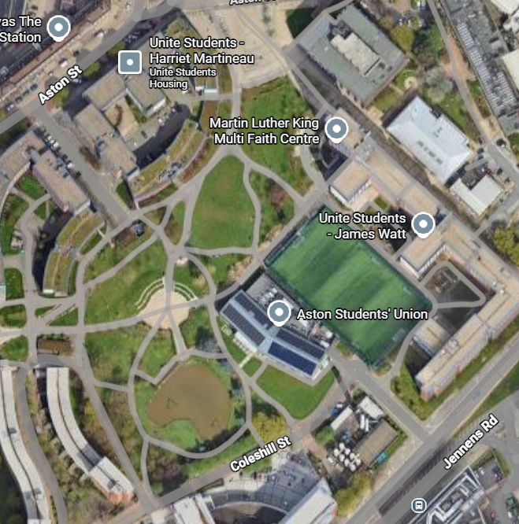
AB 6
IB 1
AB 5
AB 4
IB 2
IB 4
IB 3
AB 3
OB 2
IB 5
OB 1
AB 2
AB 1
Abstraction Borehole
Injection Borehole
Observation Borehole
IB 6
Drilling compound
Site compound

Slide 2







1

Slide 3
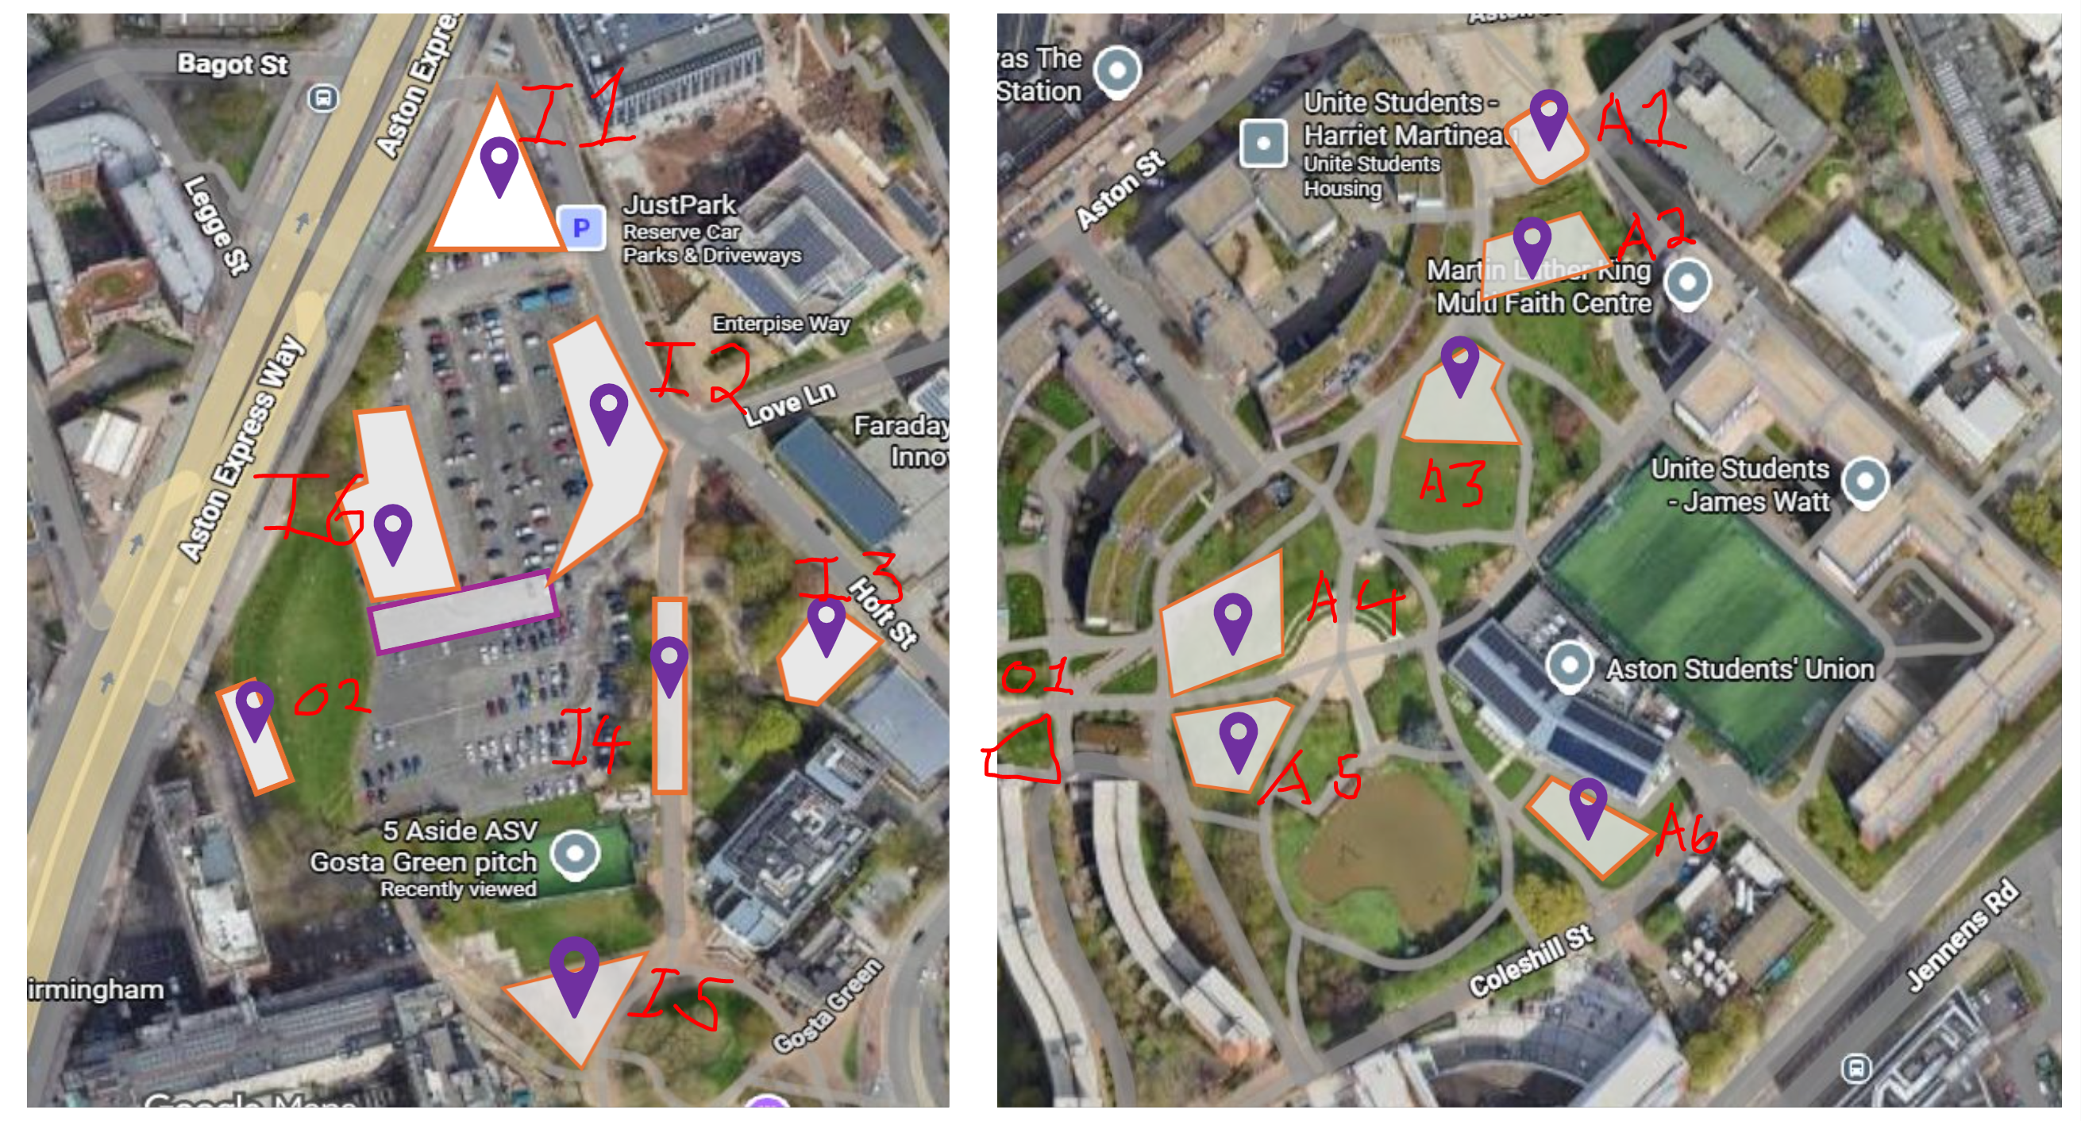

Slide 4
Abstraction Borehole
Injection Borehole
Observation Borehole

